Slide 1
Facial Emotions recognition Presented by: Aditya Sharma Roll Number: 1815601 Section: X

Slide 2
Where can you find Facial Emotions Recognition being used?
The world uses facial emotions recognition technology to identify and catch criminals.
The best examples of the facial emotions recognition is that you can now unlock your Smartphone with your face.
Did you know that every time you upload a photo on facebook, the platform uses facial recognition algorithms to identify the people in that image or that certain government around the world use facial emotions recognition technology.
The usage of facial emotions recognition models is only going to increase in the next few years.

Slide 3
About the project! facial emotions recognition:
facial emotions recognition is a method of identifying or verifying the identity of an individual using their face.
This system can be used to identify people in photos, videos , or in real-time as well.
Facial recognition is a category of biometric software that maps an individuals facial feature mathematically and stores the data as a faceprint.
The software uses deep learning algorithms to compare a live capture or digital image to the stored faceprint in order to verify an individual’s identity.

Slide 4

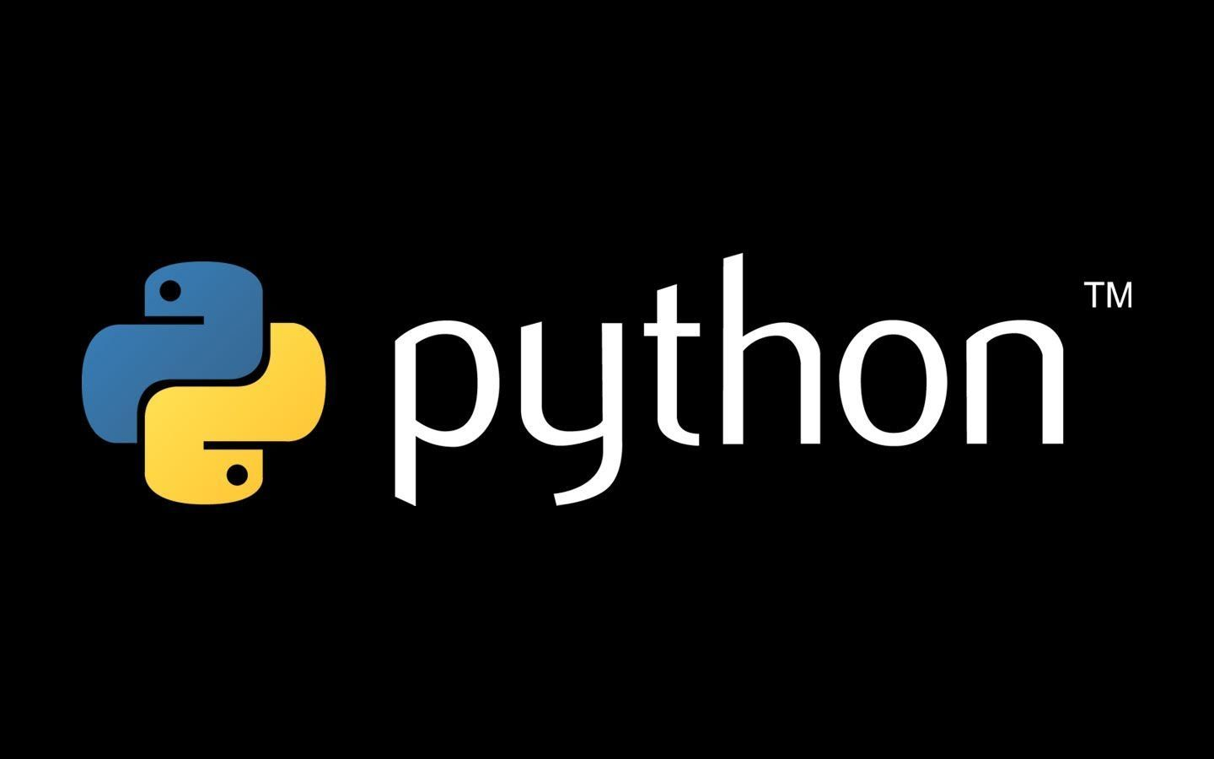
Project is made using:
Python
OpenCV

Slide 5
Technologies used:
For facial emotions recognition with Python and opencv , we need two additional libraries which are TensorFlow and Keras
Install and Import the following:
import tkinter as tk
from tkinter import *
import customtkinter
from PIL import Image, ImageTk
from tkinter import messagebox
Import os
Import cv2
Import numpy
Import matplot.pyplot

Slide 6
About the Libraries used:
TensorFlow
Keras
TensorFlow is a Python-friendly open source library for numerical computation that makes machine learning and developing neural networks faster and easier.
Keras is a deep learning API written in Python, running on top of the machine learning platform TensorFlow. It was developed with a focus on enabling fast experimentation. Being able to go from idea to result as fast as possible is key to doing good research.

Slide 7
Further libraries been used:
NumPy
matplotlib
NumPy is a library for the Python programming language, adding support for large, multi-dimensional arrays and matrices, along with a large collection of high-level mathematical functions to operate on these arrays.
Matplotlib is a cross-platform, data visualization and graphical plotting library for Python and its numerical extension NumPy. As such, it offers a viable open source alternative to MATLAB. Developers can also use matplotlib's APIs (Application Programming Interfaces) to embed plots in GUI applications.

Slide 8
FEATURES OF THE PROJECT:
The project features are as follows:
Watchlist as a service
An airtight matching algorithm
scalability
built in privacy protection.
Predictive analytics
Easy to run and use (Just open cmd, browse to the project folder and run .py file).

Slide 9
DataSet
Project is using an online dataset from www.kaggle.com
Dataset Model Training and Testing is done manualy with the help of numpy, pandas, matplotlib, keras

Slide 10
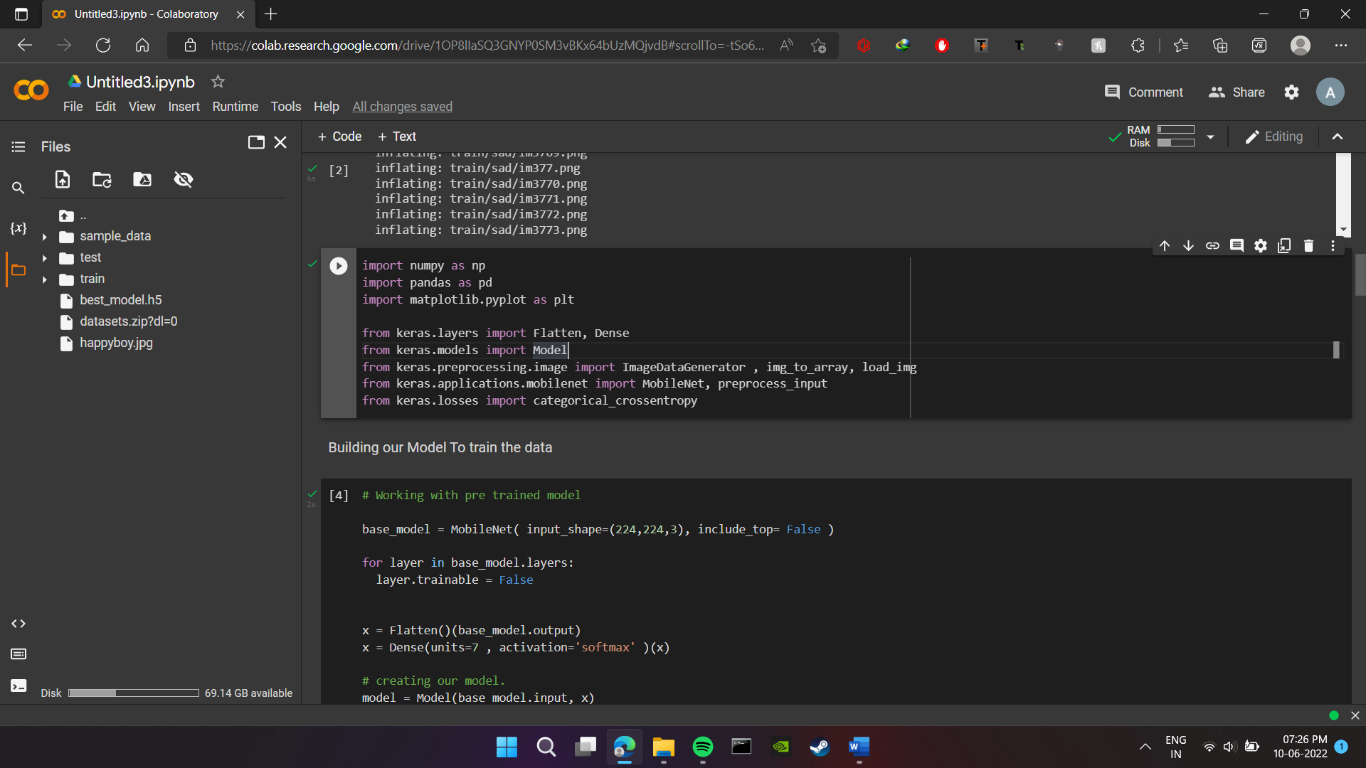
DataSet Model Testing and Training
Started

Slide 11
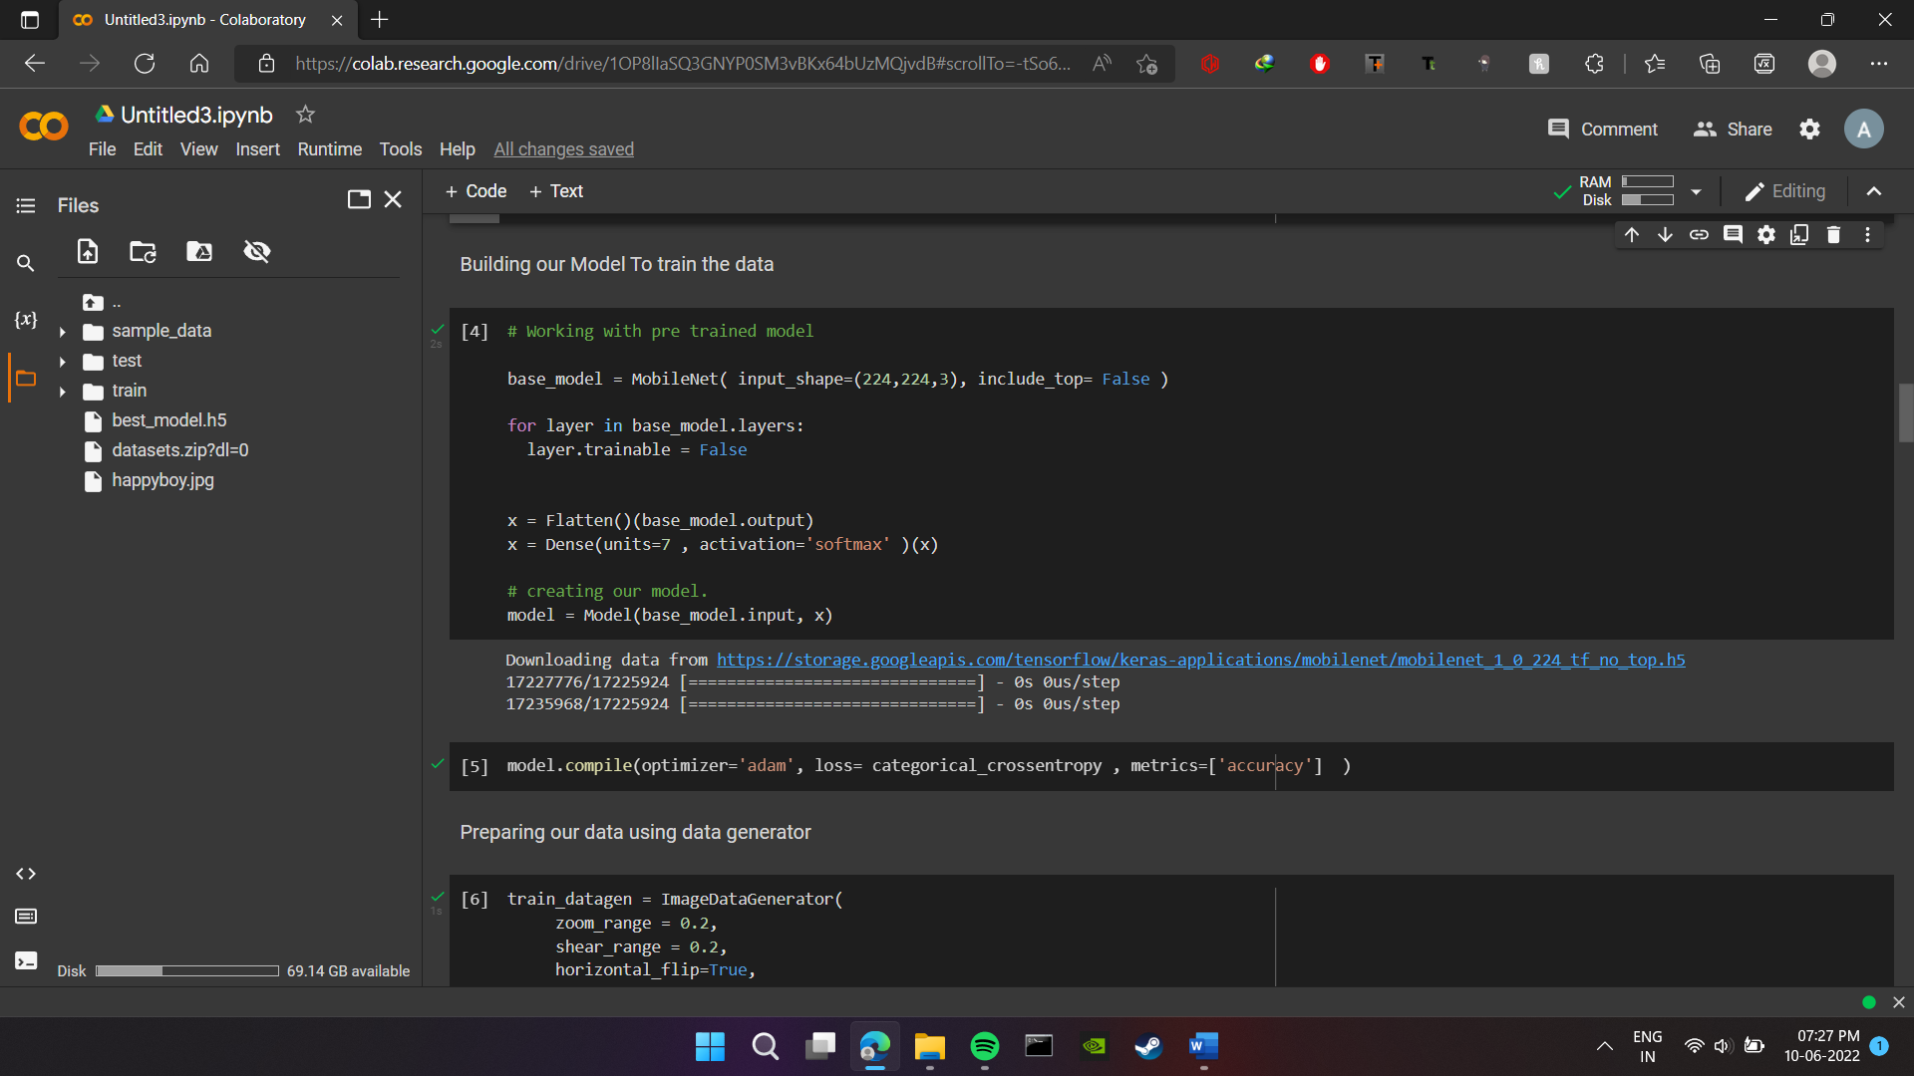
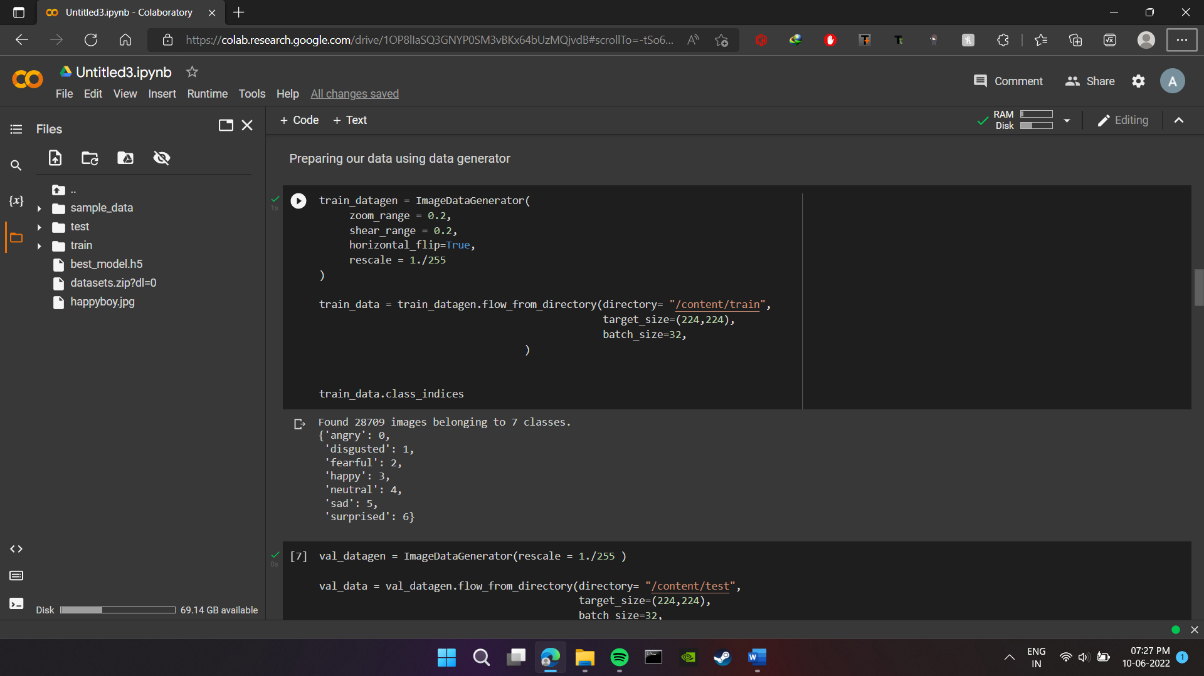

Slide 12
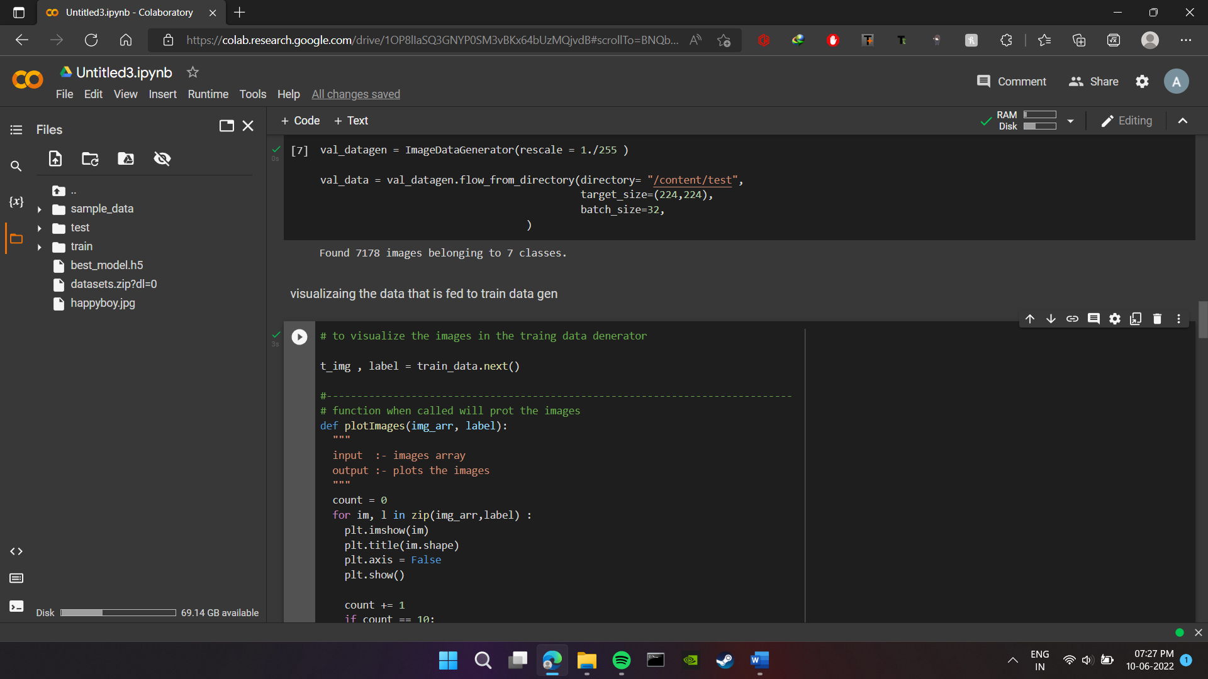
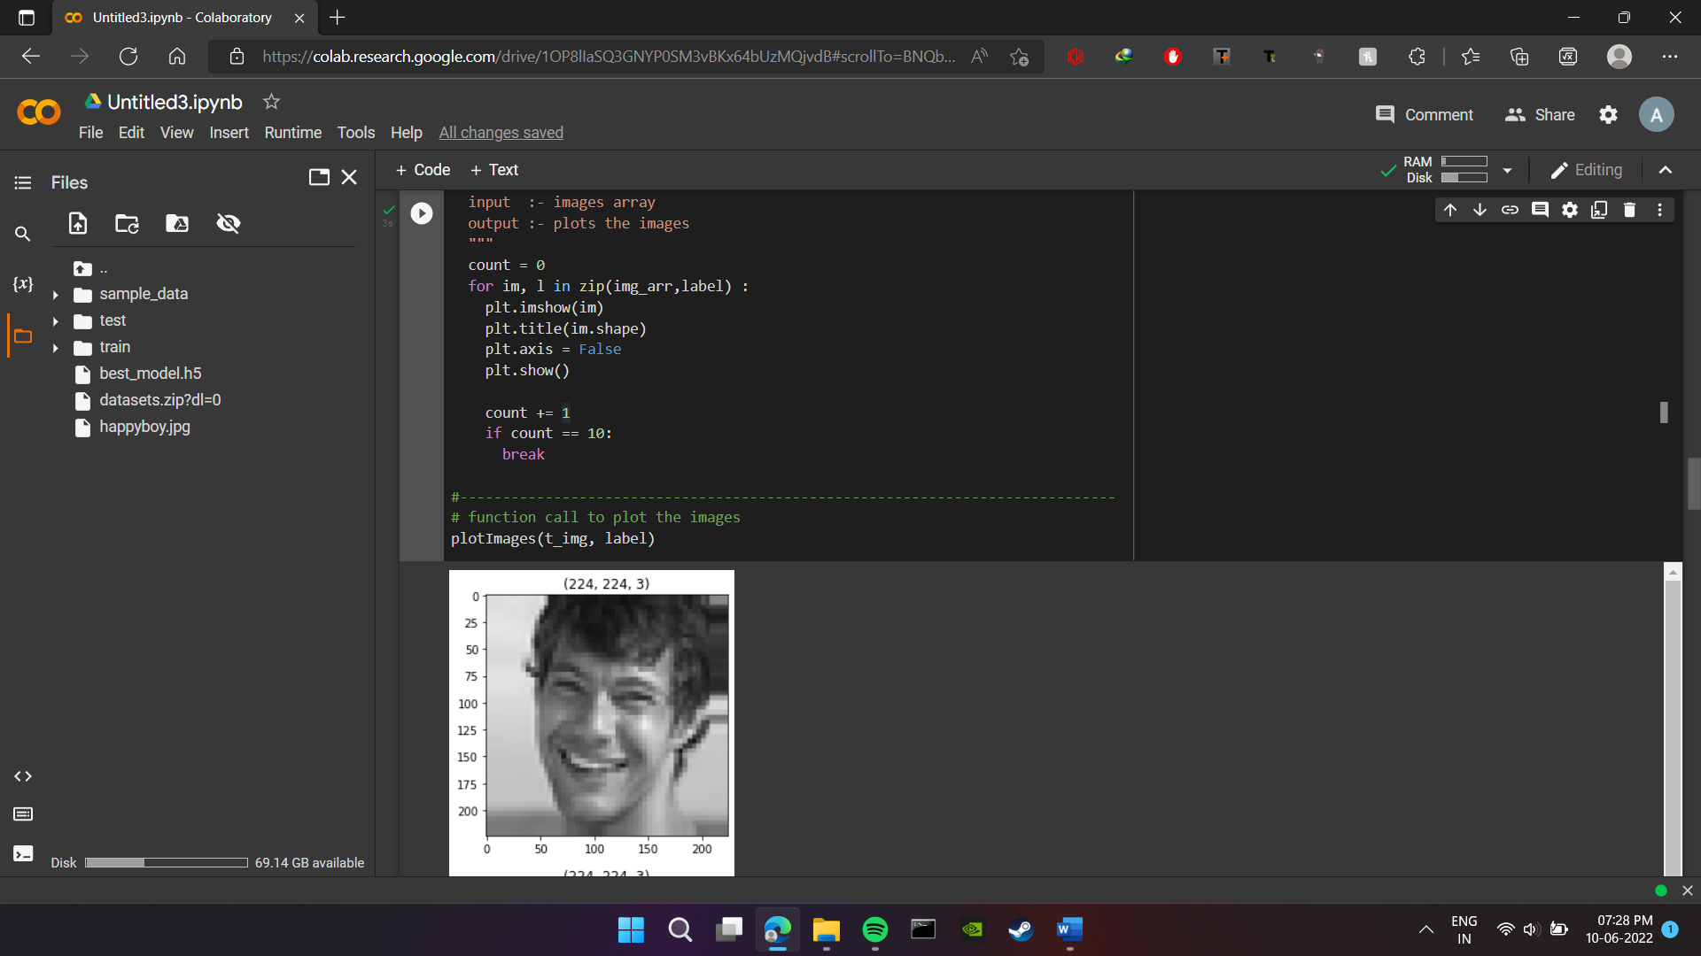

Slide 13
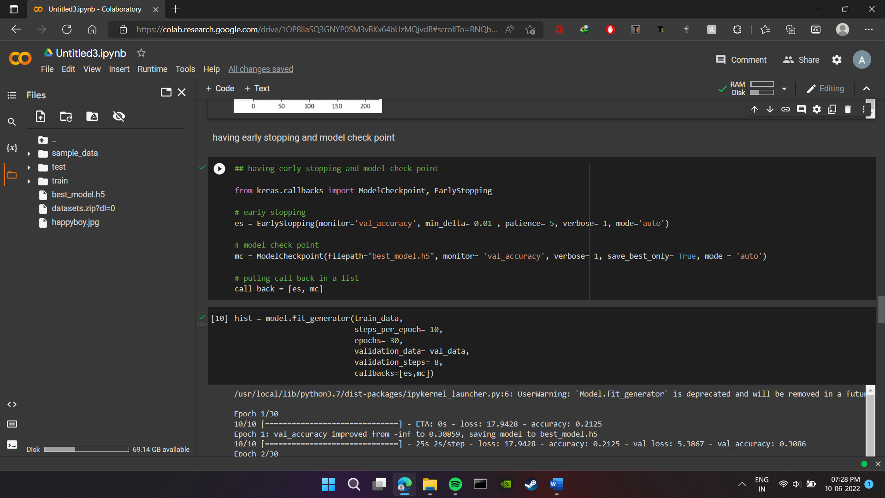
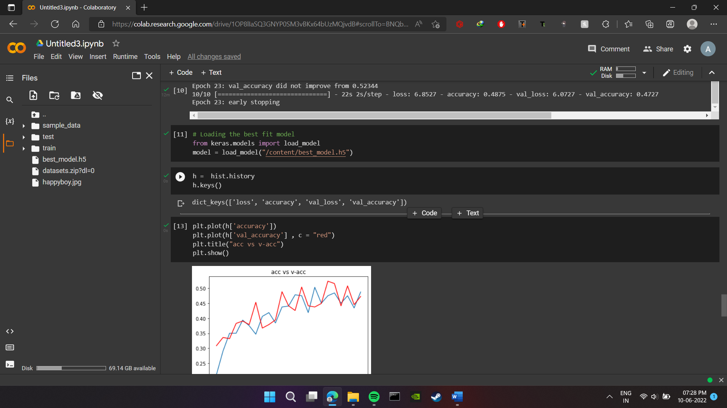

Slide 14
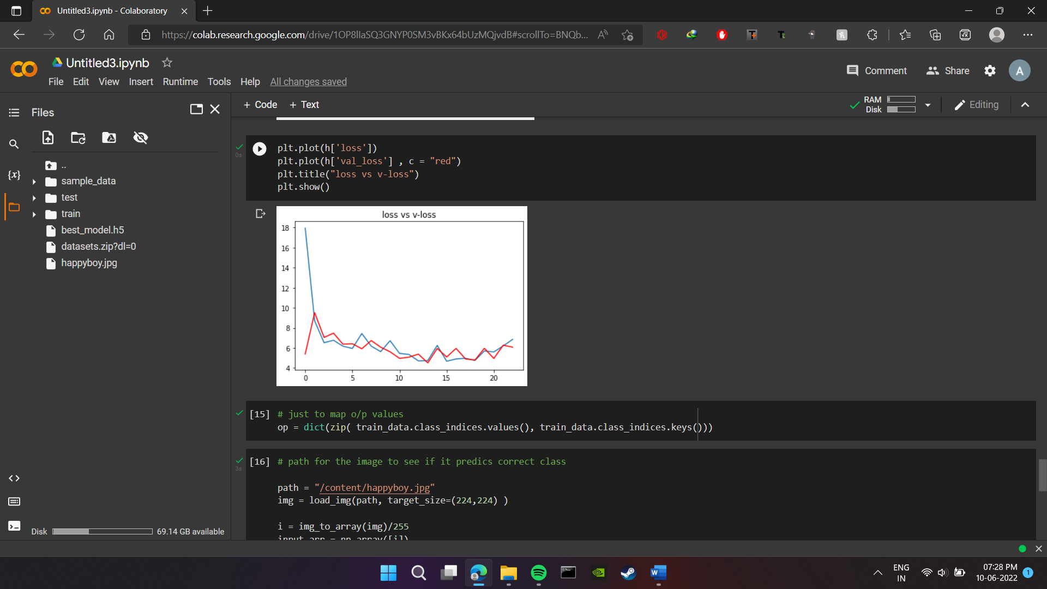
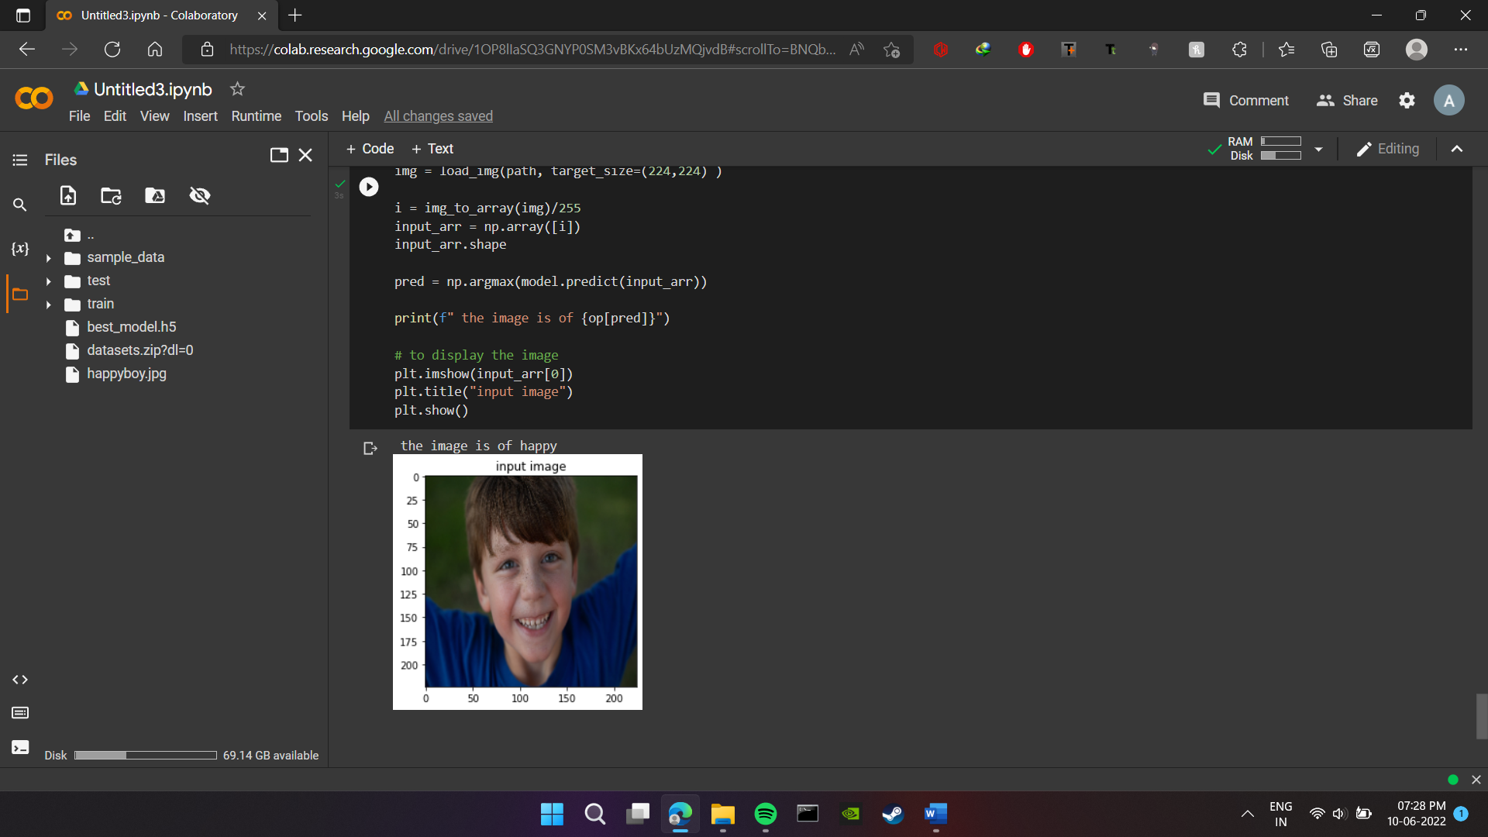

Slide 15
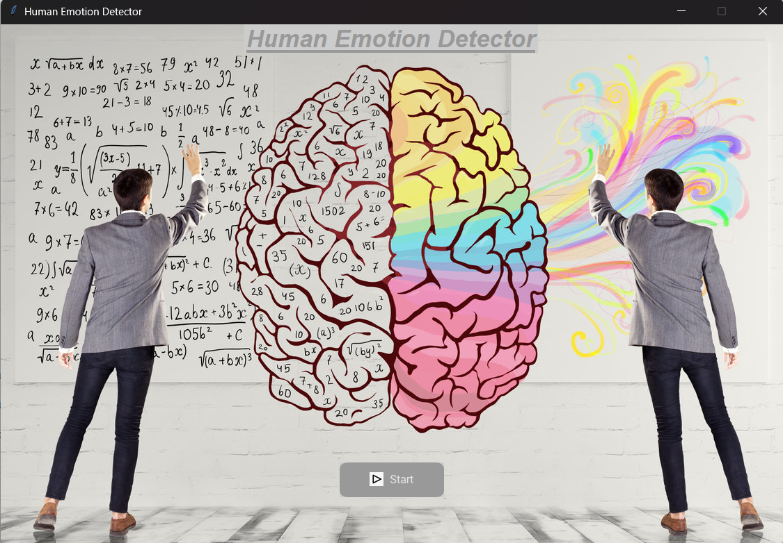
Implementation
UI

Slide 16
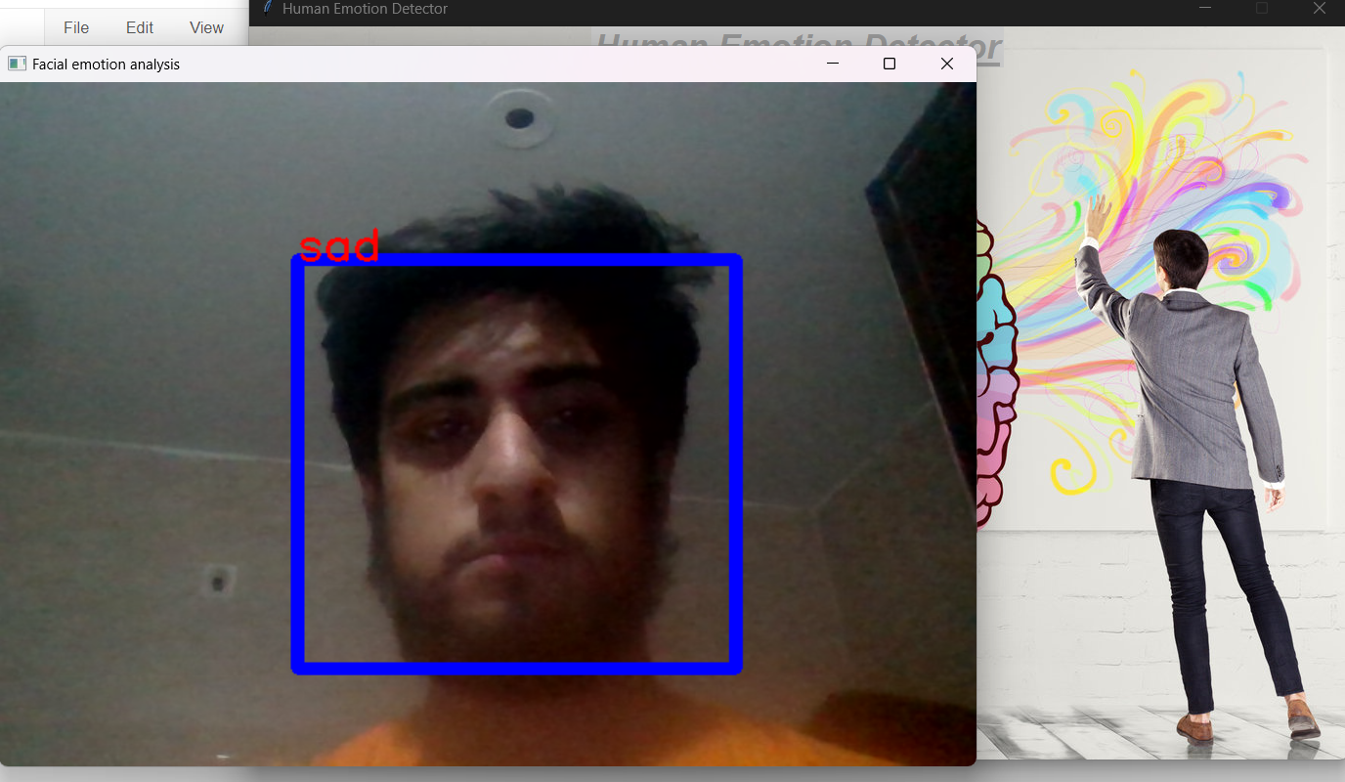
Emotion Detector

Slide 17
Thank you!!!

